Slide 1

Basic Solutions Concepts (pt 1)
Chris Kiekintveld

Slide 2
Solution Concepts for Games
Solution concepts for games can be either normative or descriptive ways of answering various questions
What is the best response for a specific player to fixed choices for the other players?
How do we predict how all of the players will play?
Are some outcomes dominated (or dominant) in some sense?
All of these concepts vary for different classes of games (with uncertainty, sequential interactions, etc.)
Different solution concepts make different assumptions (rationality, etc.)

Slide 3
Pareto Optimality
Let’s examine games from the the perspective of an outsider first
Are there any outcomes that can be said to be better than others for all of the players involved?
We have no way to say that one player’s interests are more important than another player
Players may be using different currencies, etc.

Slide 4
Pareto Dominance Idea
Idea: sometimes, one outcome O1 is at least as good for every agent as another outcome O2, and there is some agent who strictly prefers O1 to O2
in this case, it seems reasonable to say that O1 is better than O2
we say that O1 Pareto-dominates O2

Slide 5
Pareto Optimality Idea
An outcome O* is Pareto-optimal if there is no other outcome that Pareto-dominates it.

Slide 6
Pareto Optimality Idea
An outcome O* is Pareto-optimal if there is no other outcome that Pareto-dominates it.
Does every game have at least one paret0-optimal outcome?
Can a game have more than one pareto-optimal outcome?

Slide 7
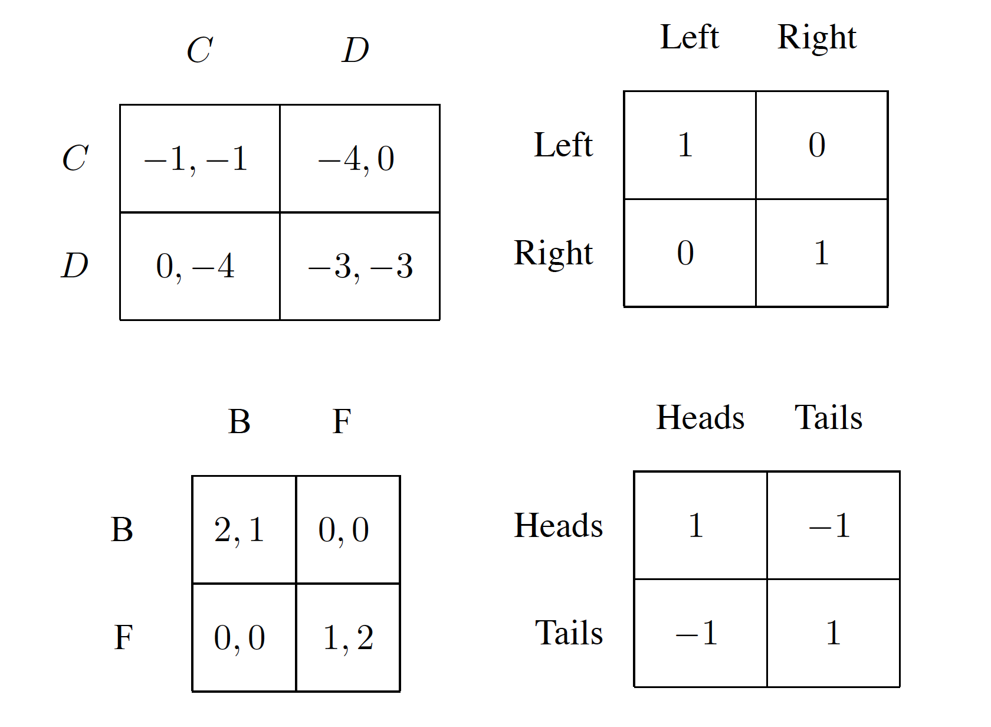
Pareto Optimal Outcomes in Canonical Games

Slide 8
Pareto Optimal Outcomes in Canonical Games

Slide 9
Pareto Optimal Outcomes in Canonical Games

Slide 10
Pareto Optimal Outcomes in Canonical Games

Slide 11
Pareto Optimal Outcomes in Canonical Games

